Slide 1
Disney | Stock Factor Analysis.
June 30, 2020

Slide 2
Agenda.
Question.
Analyses.
Summary.
What’s next?

Slide 3
Question.

Slide 4
Question.
What are some of the factors that affect the price of Walt Disney Company stock?

Slide 5

Why?
Walt Disney Company
The Walt Disney company is a diverse company that’s more than just an animated film producer.
We wanted to look at if a successful box office could affect the stock price along with other internal and external factors.

Slide 6
Analyses.

Slide 7
Analyses.
Newsworthiness.
Based on New York Times articles, does the number of articles per week represent the magnitude of change in the stock price?

Slide 8
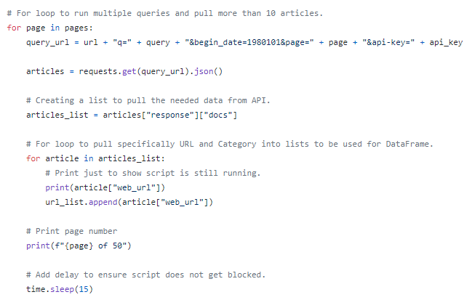
Data.
New York Times article API.
In order to pull the number articles per week, we had to create a looped python script that would request 50 pages (500 articles) from the Article Search API.

Slide 9
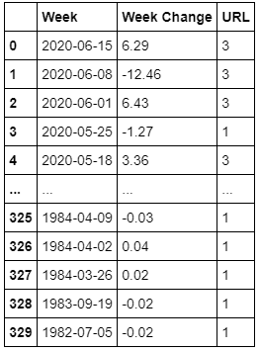
Data.
Combined data.
With historical stock price data, we were able to create a table that calculated the change in price during a specific week, along with the number of NYT articles based on publish date.

Slide 10
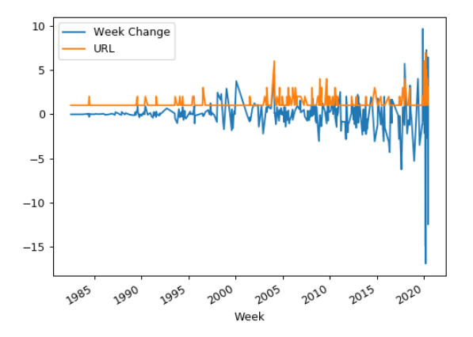
Data.
Plot.
With a quick eye test, we see occurrences of the two lines spiking together. Since we are just looking for change (positive or negative), anytime the article count spikes, we should see fluctuation with the stock price.

Slide 11
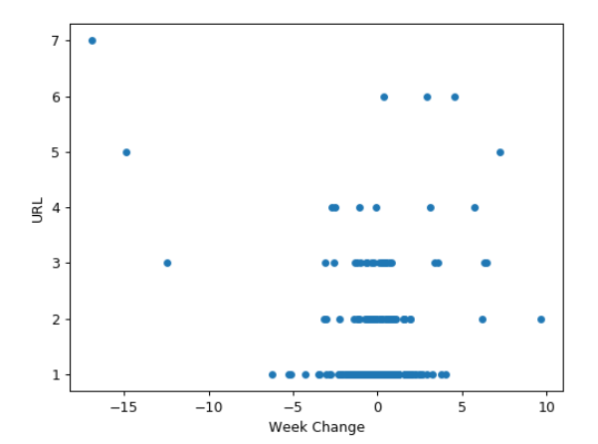
Data.
Plot again.
Using a scatter plot, we see that as we move higher up in article count, the more we see points move towards the sides, representing a large stock price change.

Slide 12
Data.
Relevant?
Insert chart for score.
Do the math calculations to see if there is correlation.

Slide 13
Analyses.
Unemployment rate and initial claims.
Does the unemployment rate and initial unemployment claims have a correlation with Disney stock price?

Slide 14
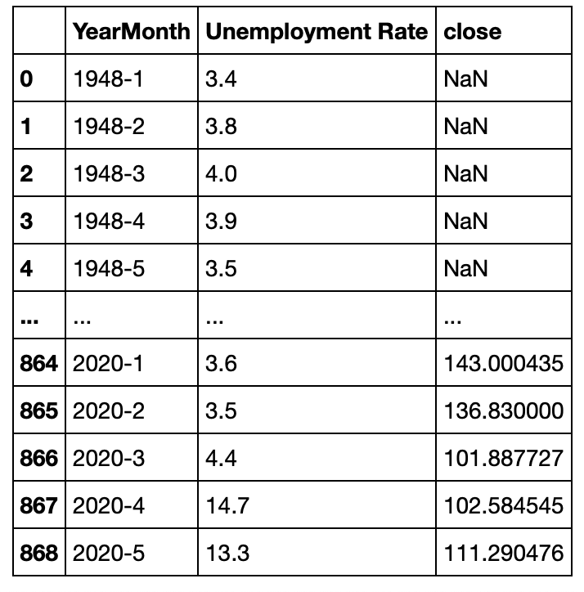
Data.
Data cleaning example.
Data cleaning for all three datasets involved formatting and grouping by Year-Month and removing rows with any null values.

Slide 15
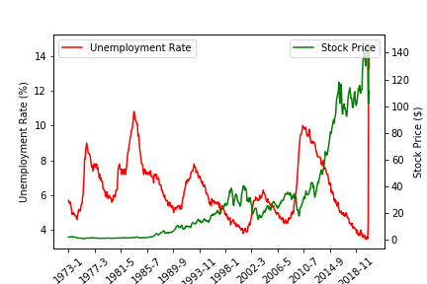
Data.
Plot.
It is evident that particularly after year 1989, unemployment rate and stock price are inversely correlated. The correlation coefficient is -0.36.

Slide 16
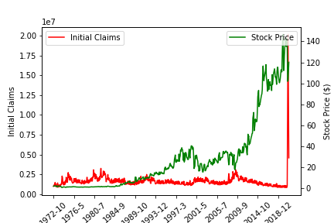
Data.
Plot again.
There is not much correlation between initial unemployment claims and stock price. The correlation coefficient is -0.02. However, we do see an interesting spike in claims after March 2020.

Slide 17
Summary.

Slide 18
Summary.
From the 5 factors we looked at, we determined # of them have a relationship with the stock price.

Slide 19
What’s next?

Slide 20
What’s next?
Look into more factors.
Connect the different factors.
Send to Walt Disney Company.
Become millionaires.

